Slide 1
Quote System Use Case
Undergraduate Group #2
John Ayling, CJ Yoder & Mitch Myers

Slide 2
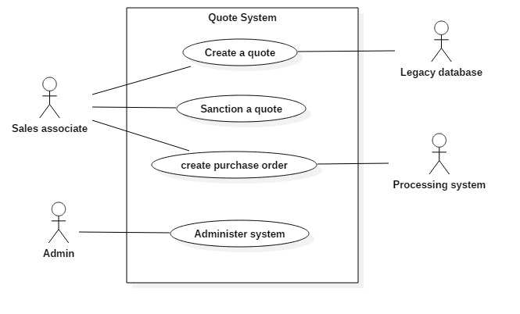
Quote System Use Case

Slide 3
Actor Dictionary
Actor | Description | Use Case(s)
Sales Associate | The Sales Associate can login to the associate logs in, (s)he can then enter sales quotes for customers. They can then convert a quote into a purchase order. | Create a quote, sanction a quote, Create a purchase order
Admin | Using the administrative interface, the admin can maintain sales associate and quote information. They can view, add, edit and delete sales associate records. The admin can also search and view quotes based on status (finalized, sanctioned, ordered), date range, sales associate, and customer. | Create a purchase order
Legacy Database | The legacy database is a list of existing customers with customer name, address, and contact info that can be used for a quote | Create a quote
Processing system | A purchase order is sent to a processing system which answers with a processing date and sales commission rate for the sales associate | Administer system

Slide 4
Quote System Use Case

Slide 5
Create a Quote Specifications
Name | Create a quote
id | 1
Scope | Quote System
Priority | High
Summary | After the associate logs in (s)he can enter sales quotes for customers. Quotes are entered for existing customers, their information is maintained in a company legacy database with customer name, address, and contact info. A quote consists of multiple line items. Each line item has a free form description and a price. The associate can also attach secret notes of free form text. The quote is entered into a new quote database. The associate also attaches a customer e-mail address to the quote, which is used as e-mail destination for communication as the quote is processed. The associate can edit quotes until (s)he finalizes the quote.
Primary Actor | Sales associate
Supporting Actor(s) | Legacy database
Stakeholders | N/A
Generalization | N/A
Include | N/A
Extend | N/A
Precondition | N/A
Trigger | N/A
Normal Flow | 1. Sales associate enters login information into the system. 2. System verifies the login information. 3. System requests customer information from Legacy database. 4. Legacy database sends customer information to the system. 5. System prompts for customer name. 6. Sales associate enters customer name. 7. System displays customer quote page. 8. Sales associate enters quotes, notes and email address. 9. Sales associate finalizes quote. 10. System saves new quote information.
Sub-Flows | N/A
Alternate Flow/Exceptions | Alternate: 3. System displays login information is incorrect. 4. Return to step #1 Exceptions: 1. Legacy database can not be reached Display error message and exit system
Postcondition | A finalized quote is created
Open Issues
Source | Problem Statement
Author | John Ayling
Revision and Date | Ver.2 7/10/2007

Slide 6
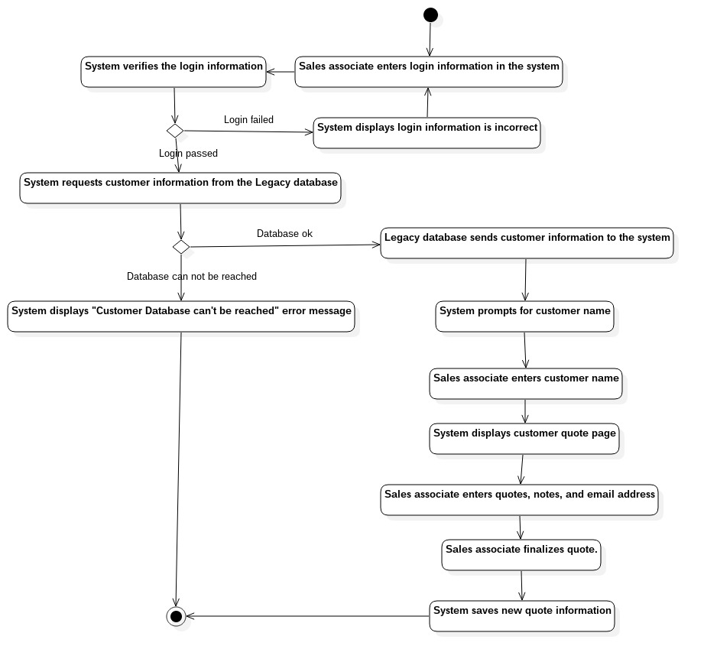
Create a Quote Activity Diagram

Slide 7
Quote System Use Case

Slide 8
Sanction a Quote Specifications
Name | Sanction a Quote
id | 2
Scope | Quote System
Priority | High
Summary | Allows the user to modify finalized quotes
Primary Actor | Sales Associate
Supporting Actor(s) | Quote Database
Stakeholders | n/a
Generalization | n/a
Include | n/a
Extend | n/a
Precondition | A quote has been finalized
Trigger | Emails a sanctioned quote to customer
Normal Flow | The system prompts Sales Associate to Edit quote The Sales Associate selects Edit The System queries quote database for finalized quotes & displays quotes The Sales Associate enters a sales quote number System displays the quote The Sales Associate makes changes to the quote The system calculates the final price and prompts if quote sanctioned or unresolved The Sales Associate commits to sanctioned quote The system prompts Sales Associate to commit changes The Sales Associate commits The system updates the quote database & emails customer
Sub-Flows | See Activity Diagram
Alternate Flow/Exceptions | See Activity Diagram
Postcondition | A sanctioned quote is created and emailed to the customer
Open Issues
Source | Problem Statement
Author | Mitch Myers
Revision and Date | Rev. 3 – 7/10/17

Slide 9
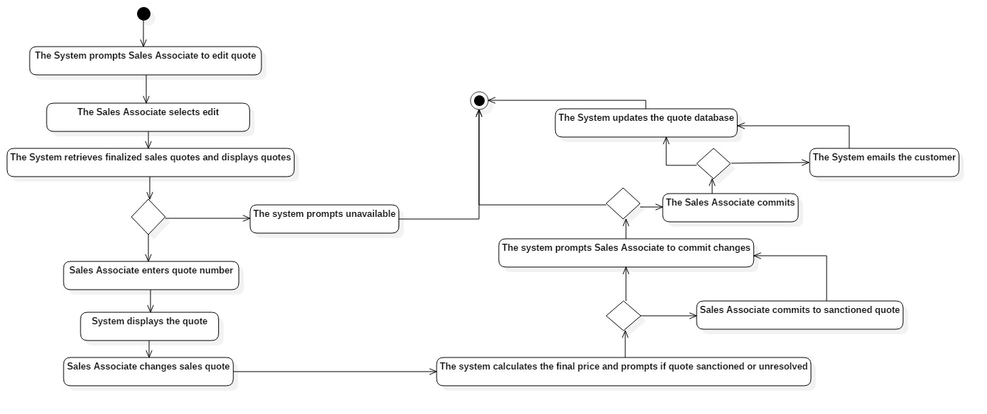
Sanction a Quote Activity Diagram

Slide 10
Quote System Use Case

Slide 11
Create Purchase Order Specifications
Name | Create Purchase Order
id | 3
Scope | Quote System
Priority | High
Summary | Converts a quote to a Purchase Order
Primary Actor | Sales Associate
Supporting Actor(s) | Processing System
Stakeholders | n/a
Generalization | n/a
Include | n/a
Extend | n/a
Precondition | Sanctioned quote sent to customer
Trigger | Sanctioned quote approved by customer
Normal Flow | The sanctioned quote is approved The Sales Associate enters quote number The System queries quote database & displays quote The Sales Associate applies final discounts to quote The System calculates the new price & prompts for confirmation The Sales Associate commits changes The System converts the quote to a purchase order The System sends the purchase order to processing system The processing system calculates a processing date The processing system calculates sales commission The processing system adds commissions to accumulated commissions The processing system stores accumulated commissions The processing system stores the purchase order details The processing system sends purchase order details to Sales Associate The processing system sends purchase order to customer The processing system closes connection
Sub-Flows | See Activity Diagram
Alternate Flow/Exceptions | See Activity Diagram
Postcondition | Purchase order is created
Open Issues
Source | Problem Statement
Author | Mitch Myers
Revision and Date | Rev 2 – 7/10/17

Slide 12
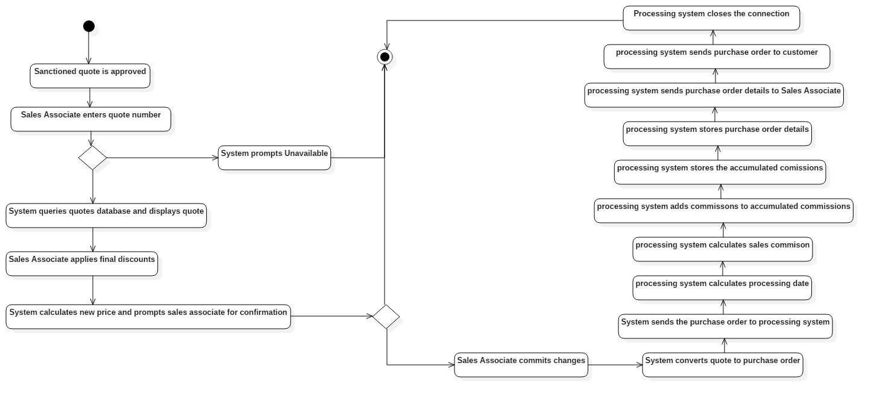
Create Purchase Order Activity Diagram

Slide 13
Quote System Use Case

Slide 14
Administer System Specifications
Name | Administer System
id | 4
Scope | Quote System
Priority | High
Summary | The Admin can manage records of sales associate and quote information.
Primary Actor | Admin
Supporting Actor(s) | N/A
Stakeholders | N/A
Generalization | N/A
Include | N/A
Extend | N/A
Precondition | N/A
Trigger | N/A
Normal Flow | System asks Admin to either manage sales associates or quotes Admin selects option System Displays a list of option for a search Admin enters search criteria System displays search option System displays quote
Sub-Flows | See diagram
Alternate Flow/Exceptions | See diagram
Postcondition | Updated Records
Open Issues
Source | Problem Statement
Author | Conrad Yoder
Revision and Date | Version 3 7/11/2017

Slide 15
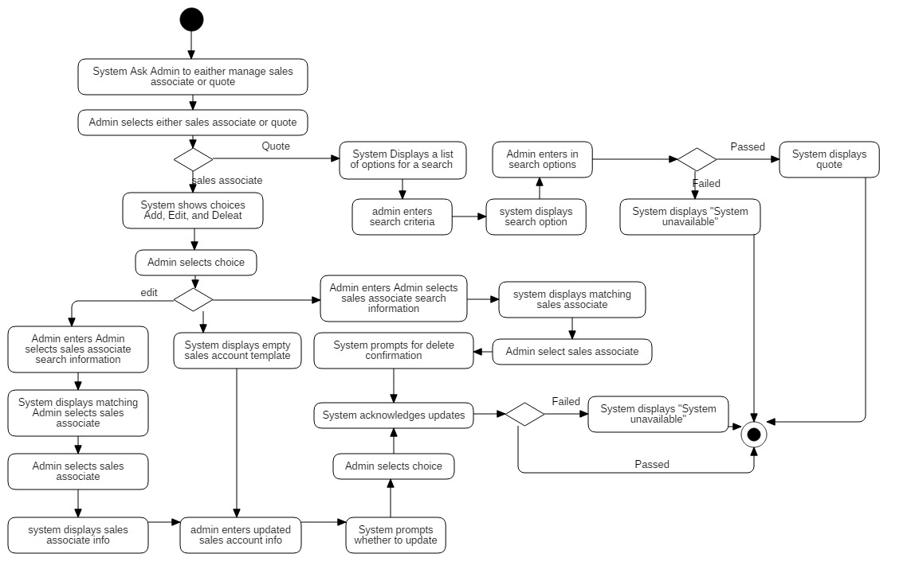
Administer System Activity Diagram

Slide 16
Thank You!
Please feel free to ask any questions

